Slide 1
March 25 - 27, 2024 | Signia by Hilton - Orlando, FL
FlukeReliability.com/xcelerate

Slide 2
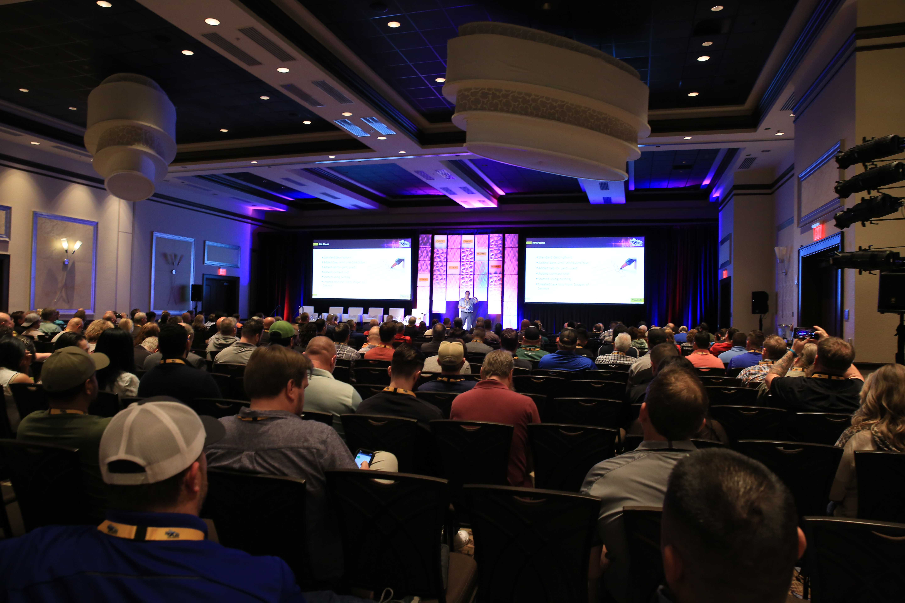
Xcelerate 2024 – Sponsors Digital Pack
TABLE OF CONTENTS
Introduction to Xcelerate24
Sponsors Welcome
Hotel Information
Local Information, Attractions & Disney Discounts
What to Expect as a Sponsor
Example Agenda
Exhibitor Schedule
Shipping
FAQs

Slide 3
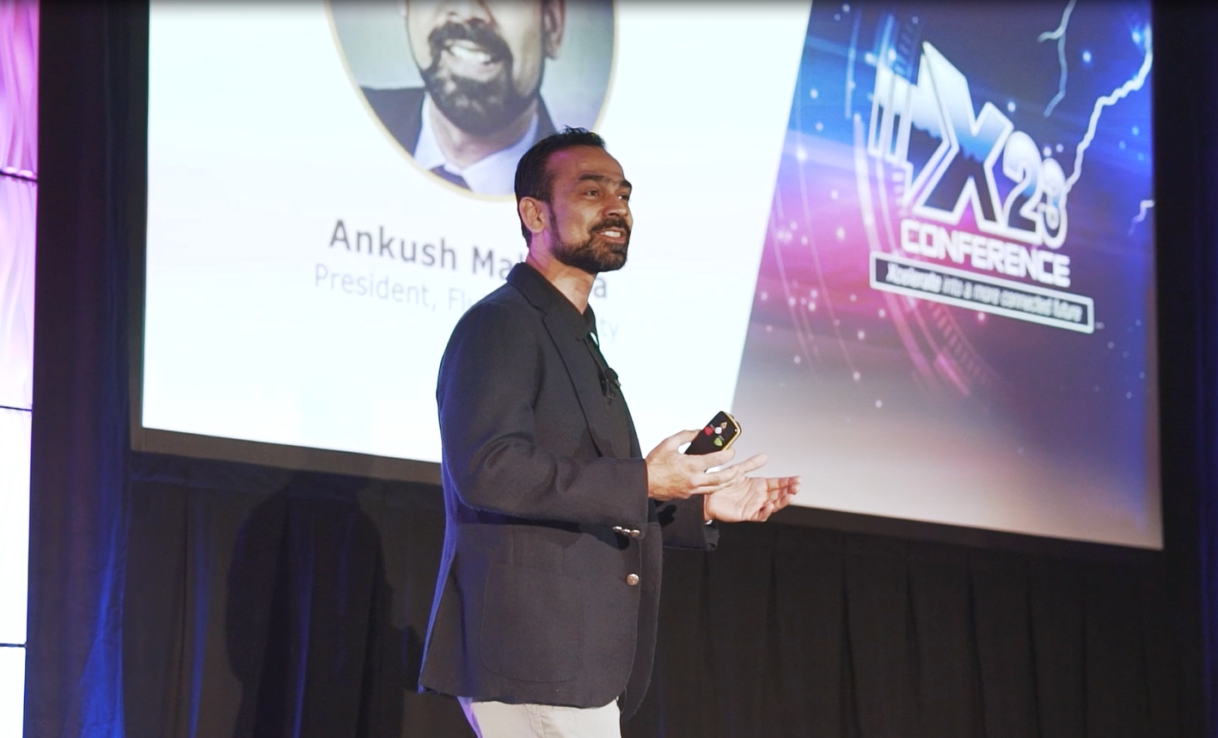
Introduction to Xcelerate 2024 – A Fluke Reliability Event
Bringing together customers across the full product and services suite of Fluke Reliability with best practices, thought leadership, technical, and training sessions.
Agenda built on four key themes/pillars, digging into industry trends that affect a full breadth of industrial facilities. Hear from customers explaining how they’ve solved complex problems with our solutions
Education and training. Have a specific problem you need to troubleshoot? Do it in real-time. Want in-depth learning and to gain a certification? This is for you. Interested in hearing more about AI, and how it can actually make a difference to your M&R strategy?

Slide 4
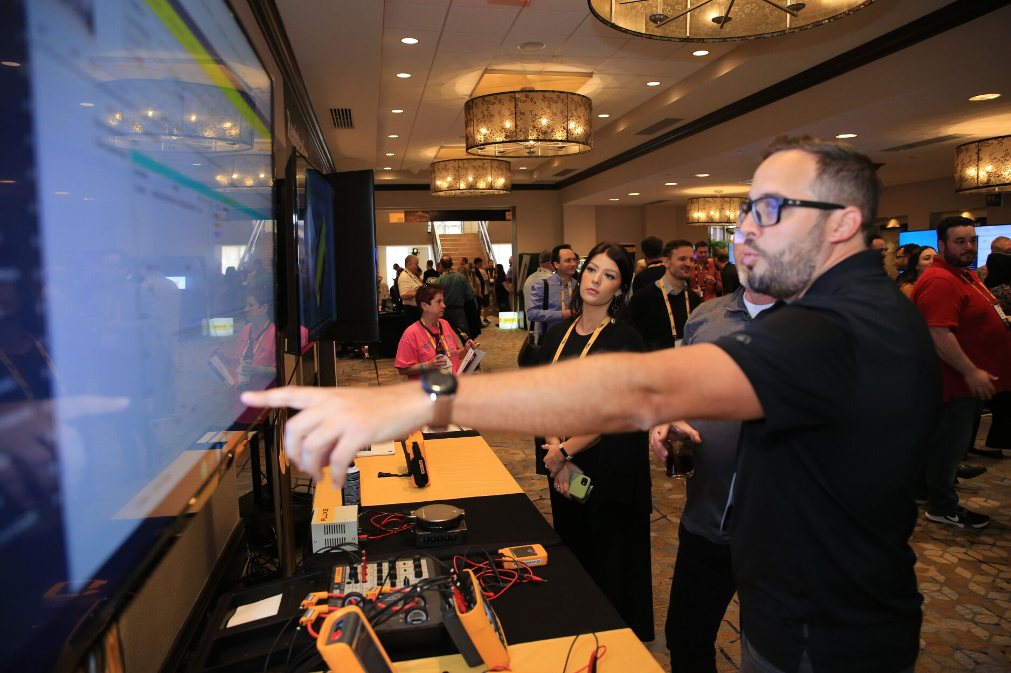
Xcelerate 2024 – Sponsors Welcome
What is Xcelerate 2024? - Ready to supercharge your business?
Xcelerate 2024 is a highly anticipated event where professionals, engineers and industry leaders come together to exchange ideas, strategies and will give you the insights and tools you need to overcome business challenges, build on your maintenance strategy, and boost your reliability efforts so your team is ready for the future.
Hosted by Fluke Reliability, this event is a platform for discussions on the latest trends, technological advancements, and best practices in the world of reliability and maintenance.
Three days of insightful presentations, networking, and knowledge-sharing with industry partners and peers.
2024 Highlights:
Xcelerate is growing! We have a new venue for 2024
Learn more about the newest member of the Fluke Reliability family, with Azima DLI sessions
Fresh format with new tracks for 2024
Keynote and session speakers to be announced … stay tuned!

Slide 5
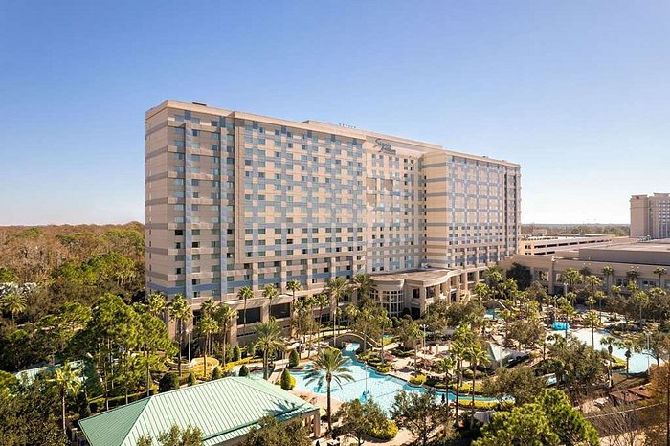
Xcelerate 2024 – Hotel Accommodations
Hilton Orlando Bonnet Creek is now Signia by Hilton Orlando Bonnet Creek, a newly- renovated resort offering an elevated experience for your stay in Orlando. The Signia is an Official Walt Disney World® Hotel, welcoming guests into a blend of inspired hospitality, and exceptional amenities. From a brand new lobby to elevated guest rooms, signature dining and innovative meetings, guests can enjoy memorable family or business experiences and best-in-class travel in iconic Orlando.
Reserve your room now: Book your accommodation
Hotel Address: 14100 Bonnet Creek Resort Lane, Orlando, Florida, 32821, USA Hotel Contact: Call Us +1 407-597-3600
Hotel Parking: 24-hour valet parking and self-parking options. The valet parking fee is $52/day. Overnight guests have in/out privileges. The self-parking fee is $36/day.
Hotel Dining: Within your Xcelerate 2024 ticket, Tuesday lunch and dinner are included, Wednesday is breakfast and lunch. Within the hotel you will find several restaurants, click here to find out more; Hilton Signia Dining

Slide 6
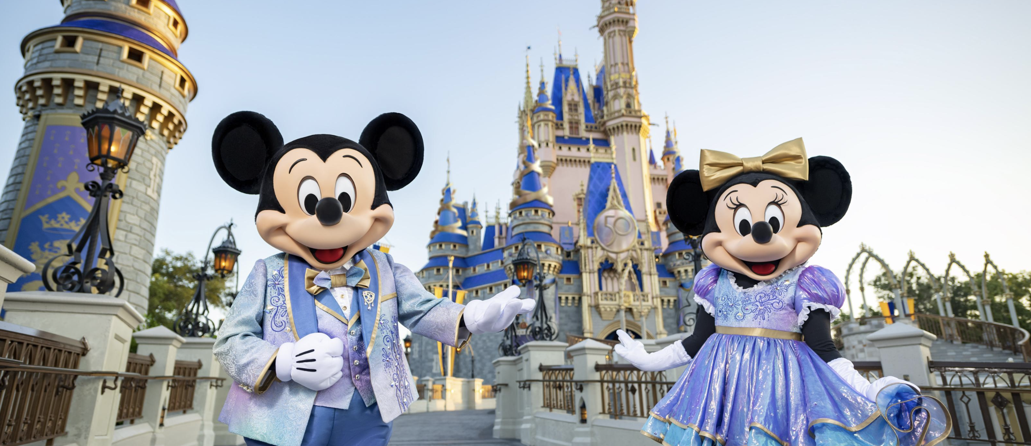
Xcelerate 2024 – Local Attractions & Discounts
Be our guest! Disney park pass discounts available, exclusive to Xcelerate 2024 attendees!
What's Nearby:
Orlando International Airport – 18 miles
Orlando Convention Center – 10 miles
Epcot® – 2 miles
Disney Springs™ – 2.5 miles
Magic Kingdom® Park – 6 miles
Disney Animal Kingdom® – 7 miles
Disney’s Hollywood Studios® – 3.5 miles​
SeaWorld & Discovery Cove – 5 miles​
Universal Studios – 12 miles​
Mall at Millenia – 15 miles​
Premium Outlets Vineland – 6 miles
Click here for more information and/or purchase discounted Disney passes, exclusive to Xcelerate attendees!

Slide 7
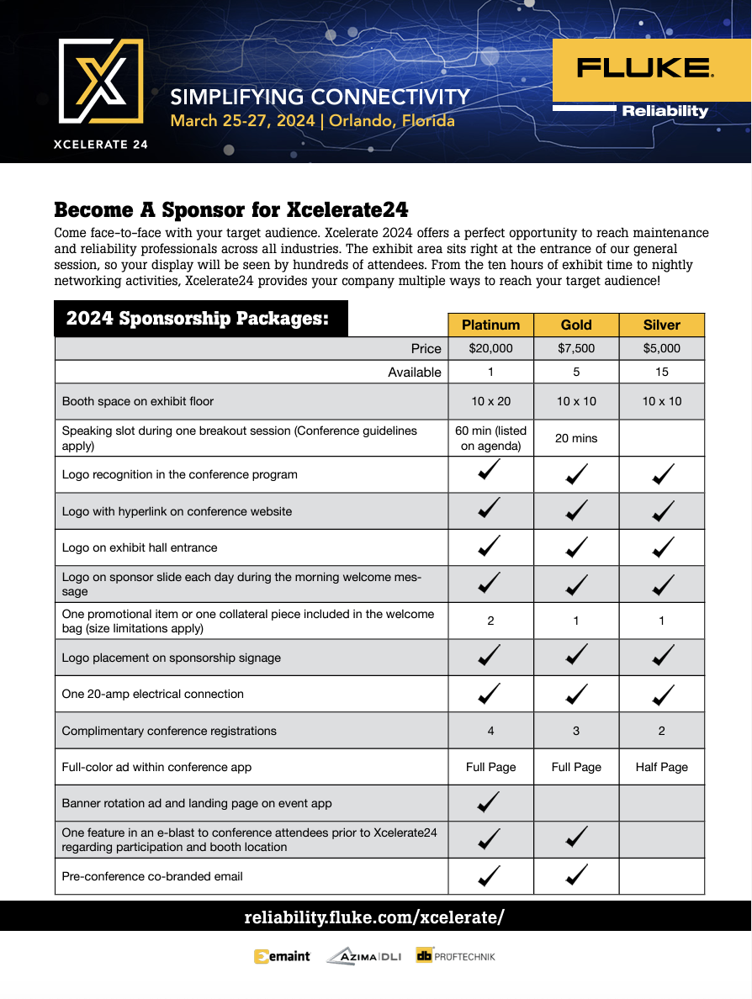
Xcelerate 2024 – What to Expect as a Sponsor
Xcelerate 2024 is an exclusive event that brings together leaders, innovators, and experts in the field of reliability and maintenance.
As a sponsor, you have the opportunity to join hands with Fluke Reliability and be a part of this extraordinary gathering. Your support not only contributes to the success of the event but also showcases your commitment to advancing the field of reliability.
Sponsorship benefits include:
Brand Exposure: Your brand will be prominently displayed throughout the event, putting your company and brand in the spotlight
Networking: Connect with industry experts, potential customers, and Fluke Reliability leaders
Thought Leadership: Position yourself as an industry leader by contributing to panel discussions and sessions
Product Showcase: Present your products and services to a highly targeted audience
Lead Generation: Access a pool of 350+ potential clients and partners
Click the image above to access the X24 sponsorship information packet

Slide 8
Xcelerate 2024 – Agenda
Our 3-day event will feel like...
A day of training
meets
An executive club
Monday, March 25 | Tuesday, March 26 | Wednesday, March 27
9 a.m. – 4 p.m. Pre-Conference Training & Testing | 8 a.m. – 10 a.m. General Session | 8:30 a.m. – 10:30 a.m. General Session
9 a.m. – 4 p.m. VIP Thought Leadership Day | 10:25 a.m. – 3:45 p.m. Breakout Sessions | 10:25 a.m. – 3:45 a.m. Breakout Sessions
4:30 p.m. – 6 p.m. Welcome Reception | 12 p.m. – 1 p.m. Lunch | 12 p.m. – 1 p.m. Lunch
7:30 p.m. – 9 p.m. Fireside Chats | 4 p.m. – 5 p.m. Keynote Speaker | 3:15 p.m. – 5 p.m. General Session & Keynote Speaker
 | 6 p.m. – 10 p.m. Poolside Evening Buffet & Networking Event | (Event End)
Click here to view full agenda and updates: Xcelerate2024

Slide 9
Xcelerate 2024 – Exhibitors Schedule
Please read the below information to ensure you have all you require ahead of Xcelerate24
The exhibit area sits near registration, home to our opening Welcome Reception, your display will be seen by hundreds of attendees.
From the 10 hours of exhibit time to the nightly networking activities, Xcelerate24 provides your company with many ways to reach your audience.
What is included within your package:
Sponsorship complimentary attendee ticket allocation:
Platinum: 4
Gold: 3
Silver: 2
10 x 10 Space with provided table (table dimensions are 6’ x 30”)
Black tablecloth
15amp Electrical plug
For any additional technical production requirements for your stand, please contact Lori Skinner
Exhibition floorplan to follow in the New Year

Slide 10
Xcelerate 2024 – Sponsor Shipping
Sponsor Shipping
Advance / Show-site Shipping
Shipments can arrive at the Hilton beginning on Friday, March 22nd.
Any shipments arriving prior to this date maybe be refused.
Labelling shipments
Please address all boxes as follows
Signia by Hilton Bonnet Creek
ATTN: Rhianna Savel (HOLD: FLUKE – insert company name)
14100 Bonnet Creek Resort Lane
Orlando, FL 32821
Box ___ of ___
Post-Event Shipping
Please utilize the Business Center to assist in all return shipping. Should you use your own carrier, please do not have them arrive prior to 4:30pm on Wednesday, March 27.
Need assistance or have oversize shipments?
Please reach out to Lori Skinner for any/all shipping questions.

Slide 11
Xcelerate 2024 – FAQs
FAQs
Website: To access the Xcelerate24 website, please follow the link here: Xcelerate24
Sponsors Pack: For view Xcelerate24 sponsors packages, please follow the link here: Xcelerate24 Sponsorship
Register: Please ensure you have registered all your team attending the event here: Xcelerate24 Register
Accommodation: To book your accommodation, if you haven’t already, please follow this link: Book your accommodation
Venue floorplans: You can view the venue’s website and floorplans, click on the link here: Signia by Hilton Floorplans
Venue location: To view the venue location on a map, please click here: Venue Map
Venue parking: Parking is available onsite, to book a parking space please call the hotel directly at +1 407-597-3600
Event App: Access to the event app will go live prior to Xcelerate24, we will notify you once the app is live
Sponsors App Page: We will have a dedicated sponsors page on the Xcelerate24 event app, your logo with link to your website will appear
Promo Item: As part of your package, you have the option to provide one promotional item or one collateral piece in the welcome bag
Your promotional item must be given to the onsite Xcelerate24 Registration Desk on arrival Monday, March 25 for placing
within the delegate bags. Item must not be larger than 8.5” x 11” and approved prior to March 25.
Shipping: For shipping to the hotel, please see the separate instructions sent with this pack
Please ensure your packages are clearly labelled as we will have many deliveries expected as part of this event
Equipment: Should you need a monitor, laptop, or computer accessories, please let us know by Thursday, March 7.
Rental costs is the responsibility of the sponsor.
Contact: For any queries leading up to the event or onsite, please call, text or WhatsApp: Sarah Baumann | Field Marketing Manager, End User (ABM) & Channel Campaigns I M: +1 918-899-6097

Slide 12
We look forward to seeing you
in Orlando!
FlukeReliability.com/xcelerate

